Slide 1

Bankruptcy Prevention
Mr. Aabhas Ahluwalia
Ms. Namrata D Garag
Mr. Sam Anpin Theradiyil
Jayanth Pendyala
Samrudhi Jotiram Mahadik
Kaveti Lakshmi Narayana
Fardeen Mohammed Zafar Khatri

Slide 2
Business Objective
This is a classification project, since the variable to predict is binary (bankruptcy or non-bankruptcy). The goal here is to model the probability that a business goes bankrupt from different features.
The data file contains 7 features about 250 companies
The data set includes the following variables:
1.Industrial_risk: 0=low risk, 0.5=medium risk, 1=high risk.
2.Management_risk: 0=low risk, 0.5=medium risk, 1=high risk.
3.Financial flexibility: 0=low flexibility, 0.5=medium flexibility, 1=high flexibility.
4. Credibility: 0=low credibility, 0.5=medium credibility,1=high credibility.
5. Competitiveness: 0=low competitiveness, 0.5=medium competitiveness, 1=high competitiveness.
6. Operating risk: 0=low risk, 0.5=medium risk, 1=high risk.
7. class: bankruptcy, non-bankruptcy (target variable).

Slide 3
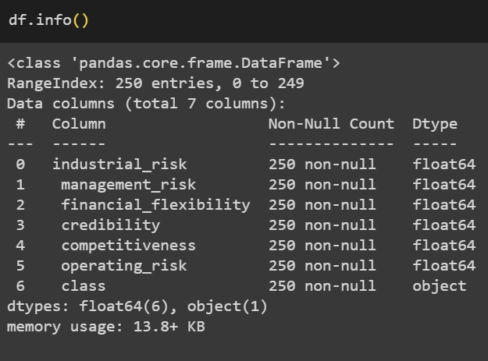
Info
The info() method prints information about the Data Frame.
The information contains the number of columns, column labels, column data types, memory usage, range index, and the number of cells in each column (non-null values).

Slide 4
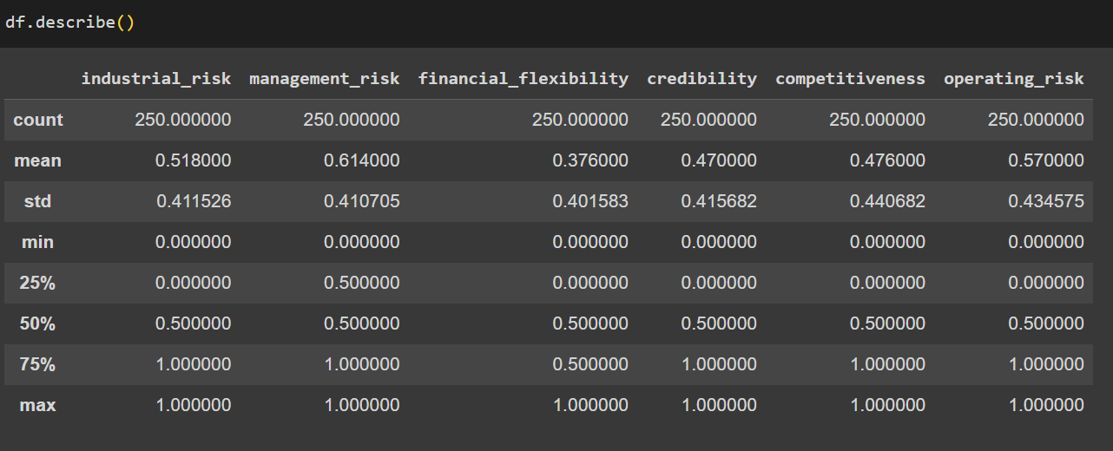
Describe
The describe() method returns description of the data in the Data Frame.
It shows count , mean , standard deviation ,minimum value , maximum value,25% value,50% value ,75% value and maximum value of each column.

Slide 5
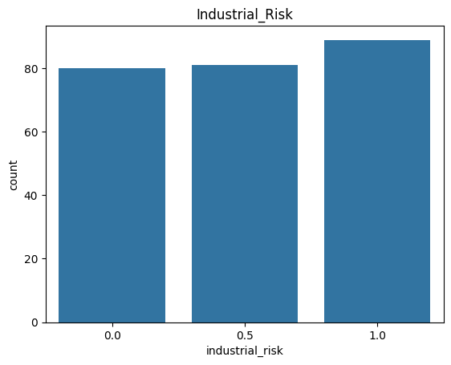
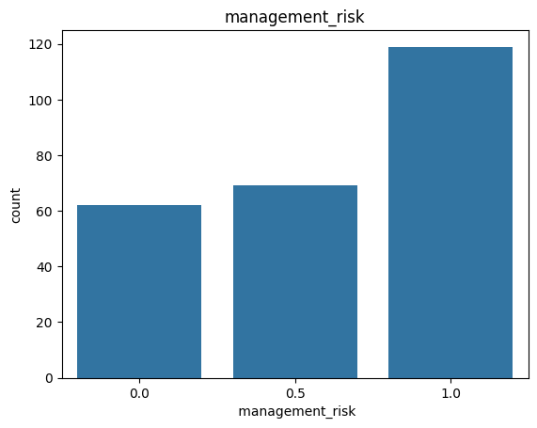
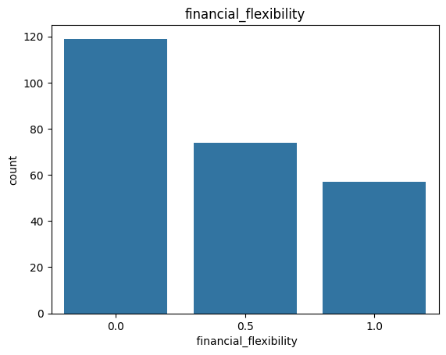
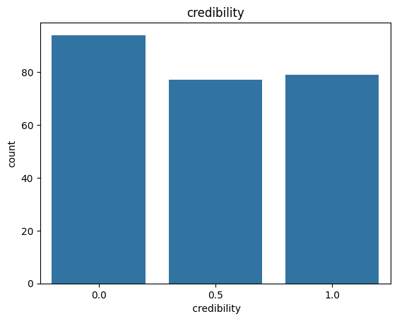
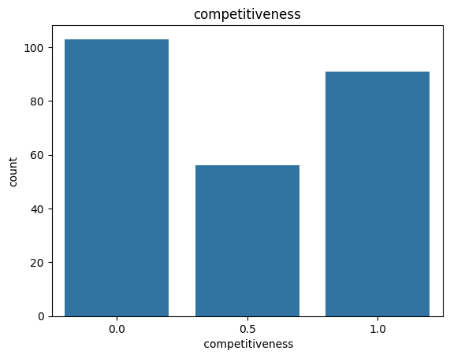
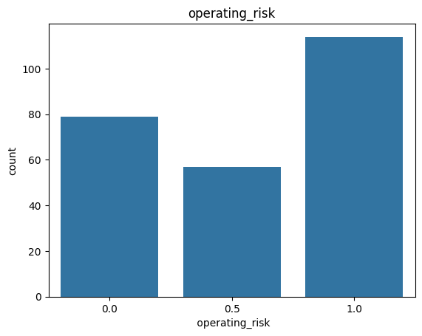
Count plot
Count plot for each Columns.
As the dataset contains discrete values it is used to count the frequency of values of each and every column.

Slide 6
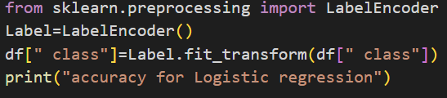
Label Encoder
Converting class column into Numerical form as it is in categorical form
Label encoding is a technique used in machine learning and data analysis to convert categorical variables into numerical format. It is particularly useful when working with algorithms that require numerical input, as most machine learning models can only operate on numerical data.

Slide 7
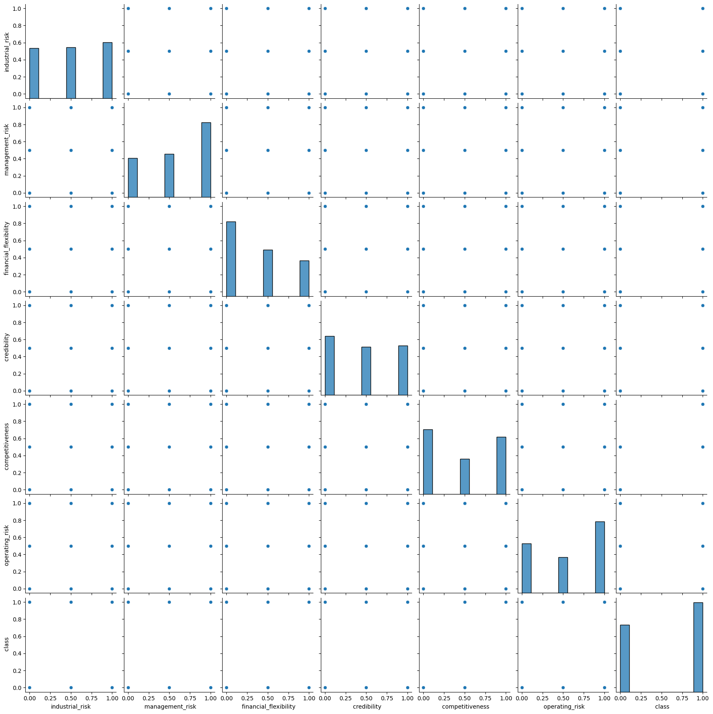
Pair Plot
Pair plot function allows the us to create an axis grid via which each numerical variable stored in data is shared across the X- and Y-axis in the structure of columns and rows. The pairplot() function can also be used to showcase the subset of variables, or we can plot different types of variables on rows and columns.

Slide 8
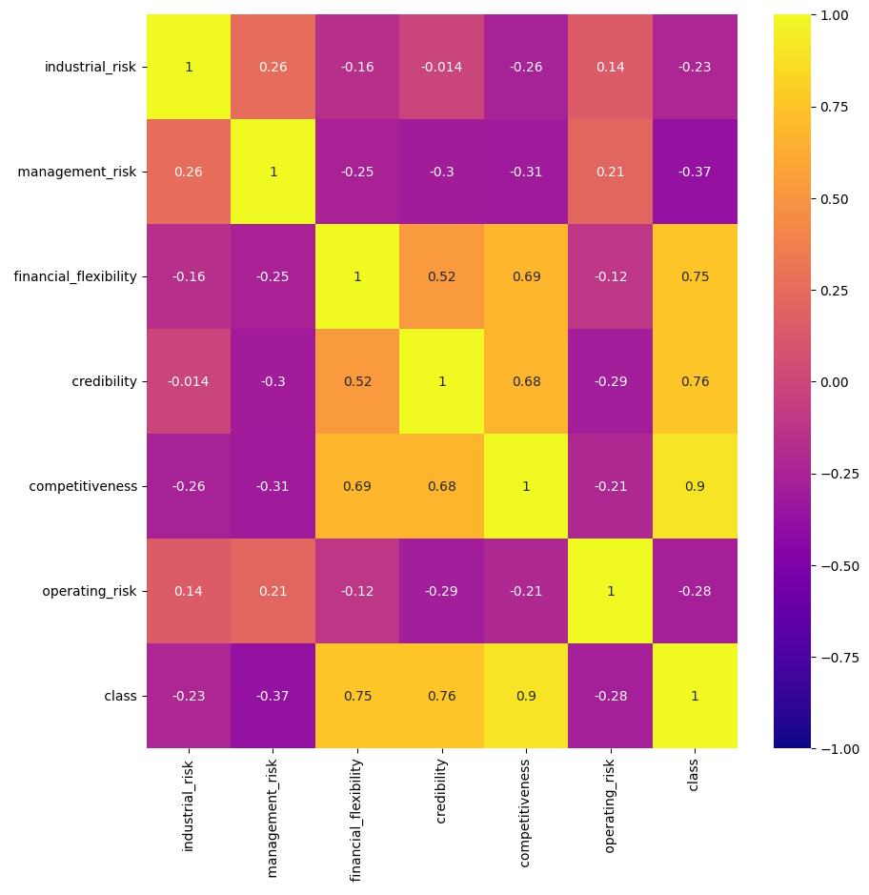
Heat Map
Heatmap defines the correlation .
It provides a tabular representation of the correlation coefficients between multiple variables. It provides a comprehensive overview of the relationships between variables.

Slide 9
Model Building
Accuracy
Accuracy for the logistic regression model is 1.0
Accuracy for the Decision Tree model is 0.98
Accuracy for the SVM model is 1.0
Logistic regression Model
Decision Tree
SVM Model

Slide 10
Thank You

